Slide 1

DATA 606:
Capstone in Data Science
Portfolio Risk Analysis
Group Members:
Chirag Jadav
Harshil Prajapati

Slide 2
Objective
To analyze the risk associated with a portfolio of stocks.
Steps involved: Data Collection, Data Cleaning, EDA, Model Selection, Model Training and Testing, Model Evaluation, Result Interpretation, Conclusion, Deployment.

Slide 3
Data Collection
We have used the Yahoo Finance API to gather historical daily closing price data for each stock in the portfolio.
It begins by importing the necessary libraries pandas_datareader and yfinance, and defining start and end dates for the data.
The user then inputs a stock symbol, and the program retrieves data on that stock from Yahoo Finance.

Slide 4
Code Insights
The program displays a menu of options for the user to choose from.
If the user selects option A: The program prompts the user to input a start and end date for the price chart of their chosen stock, retrieves the data from Yahoo Finance, and plots the adjusted closing price of the stock using the plotly library.
If the user selects option B: Here we are showing the return analysis of the stocks in our portfolio. First we computed daily return of the selected stocks and determined the correlation between them. We also calculated the volatility and computed the risk return trade-off of all the stocks.

Slide 5
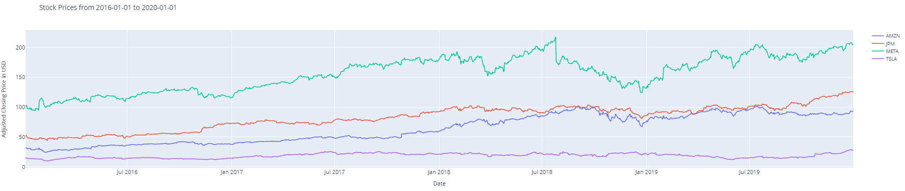
Stock Adj Closing Price

Slide 6
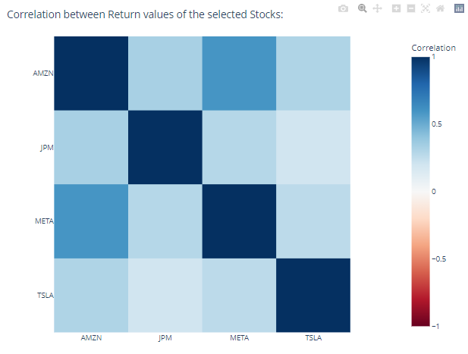
CORRELATION

Slide 7
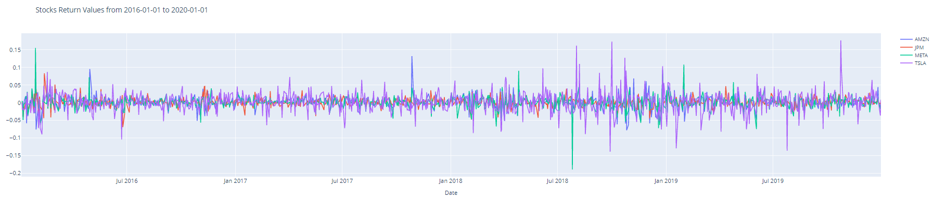
STOCK RETURN VALUES

Slide 8
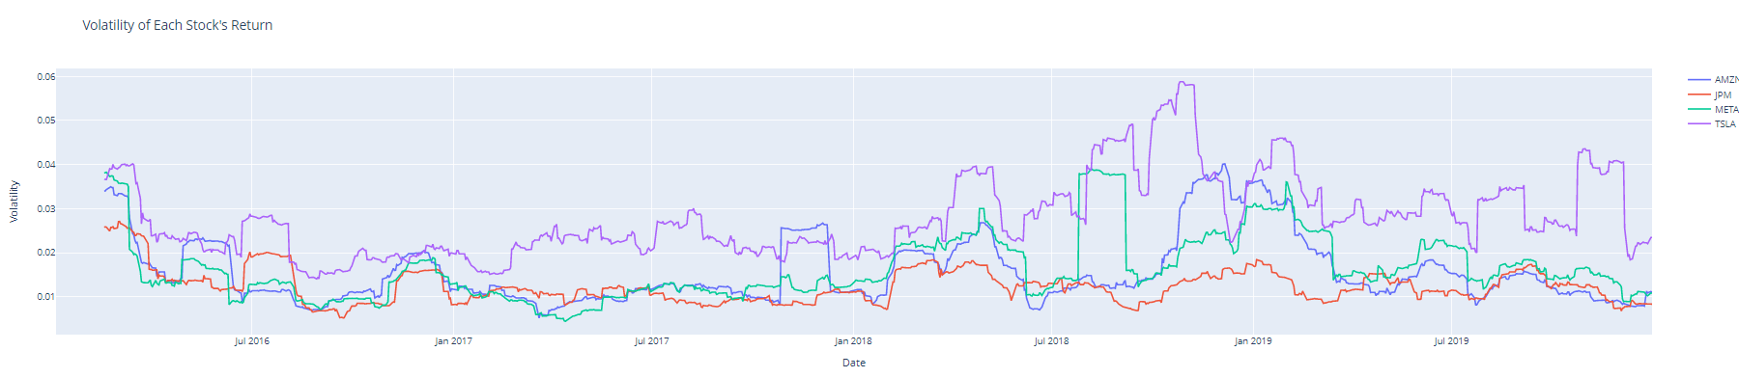
VOLATILITY

Slide 9
THANK YOU

